Slide 1
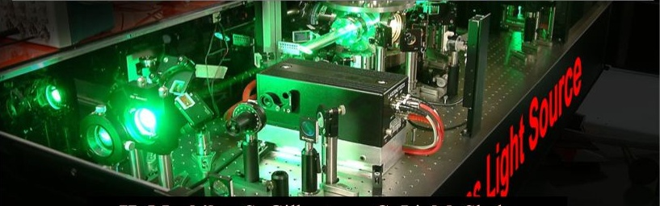
Kansas Light Source
Laser System
J. R. Macdonald Laboratory
Department of Physics, Kansas State University
September, 2010

Slide 2
Kansas Light Source:
Amplified Ti:Sapphire Laser System
Amplifier
Notes:
What is KLS?

Slide 3
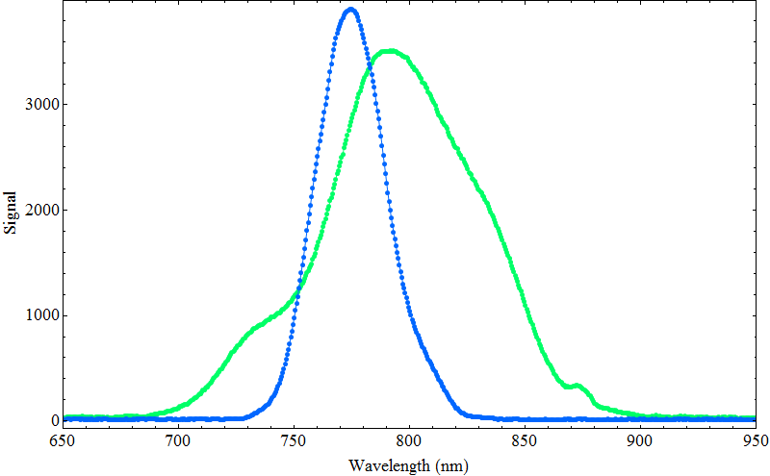
KLS output
Mode-Locked
Ti:Sapphire Oscillator
Multi-pass
Ti:Sapphire Amplifier
350 mW Average Power
12 fs Pulse Width
80 MHz Repetition Rate
5 nJ Pulse Energy
800 nm Central Wavelength
95 nm Bandwidth
4 W Average Power
27 fs Pulse Width
2 KHz Repetition Rate
2 mJ Pulse Energy
780 nm Central Wavelength
40 nm Bandwidth
Notes:
What is KLS?

Slide 4
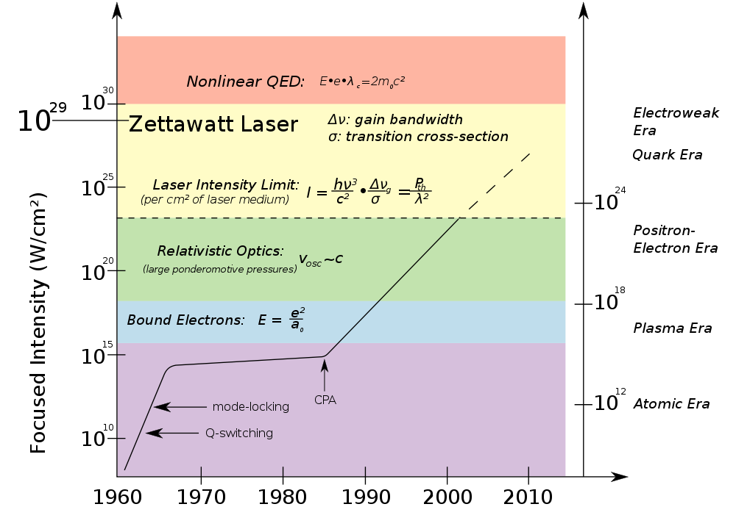
Light Amplification by Stimulated Emission of Radiation
Notes:
With this output, where are we?

Slide 5
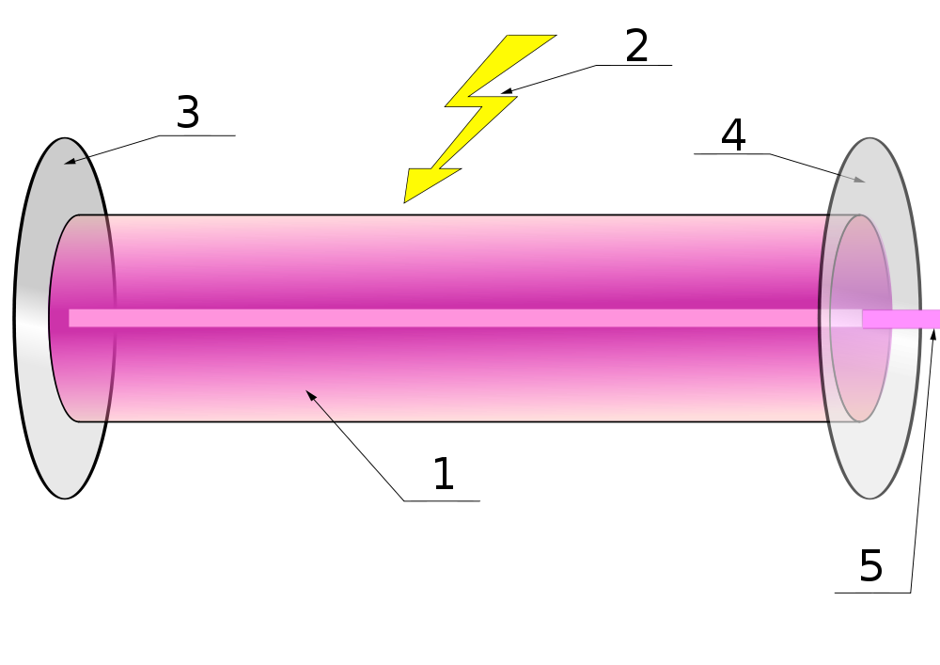
Light Amplification by Stimulated Emission of Radiation
Pump
Cavity mirror
Cavity mirror/output coupler
Laser medium
Laser output
Optical cavity→ LASER
Notes:
What’s laser?

Slide 6

Interaction of light with matter
In laser medium
Spontaneous
emission
Stimulated
emission
Absorption
Population inversion → LASER
Notes:
How to lase?

Slide 7
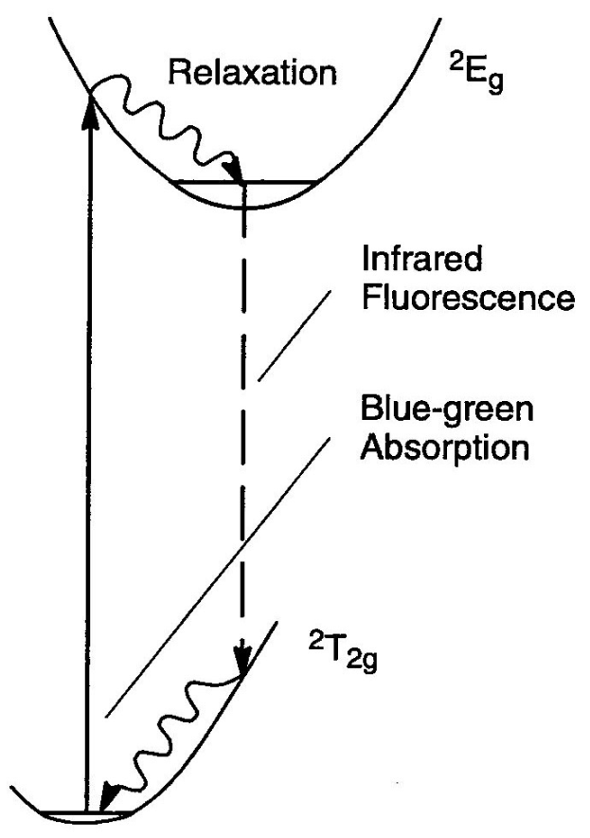
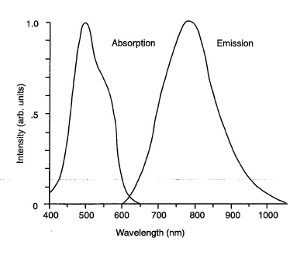
Ti:Sapphire crystal
Ti³⁺:Al₂O₃

Slide 8
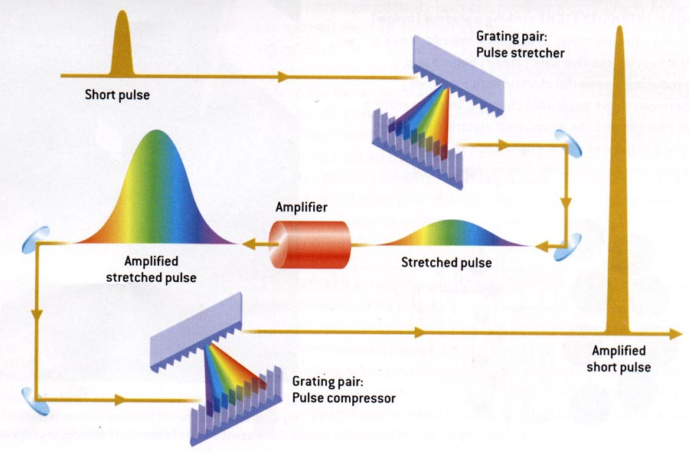
Chirped Pulse Amplification

Slide 9
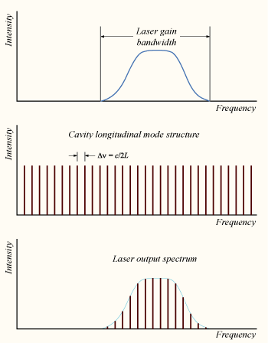
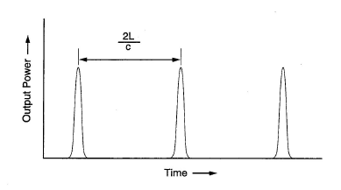
Mode-locked oscillator

Slide 10
KLS oscillator -- FemtoLaser

Slide 11
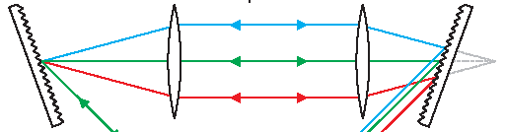
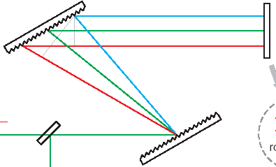
CPA stretcher/compressor
Positive
Dispersion
Negative
Dispersion

Slide 12
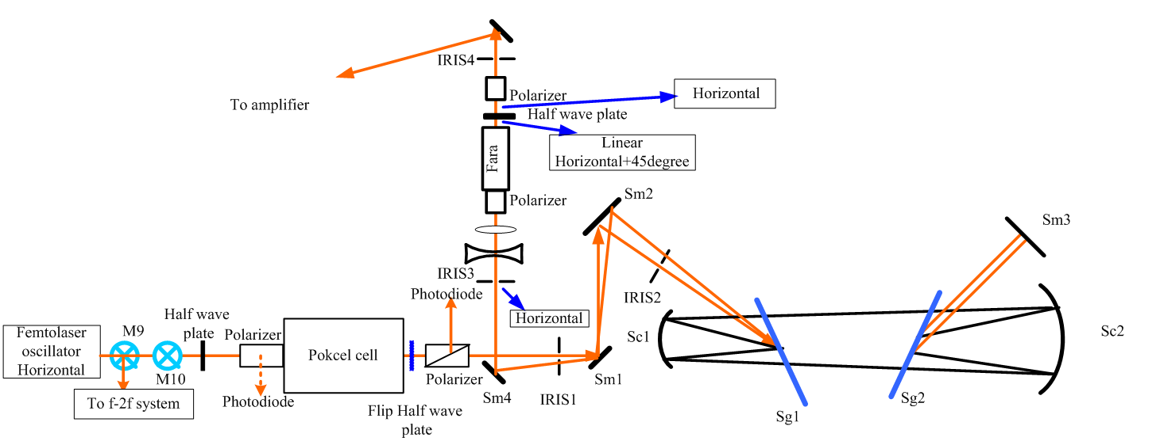
KLS stretcher

Slide 13
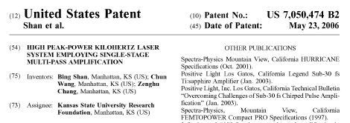
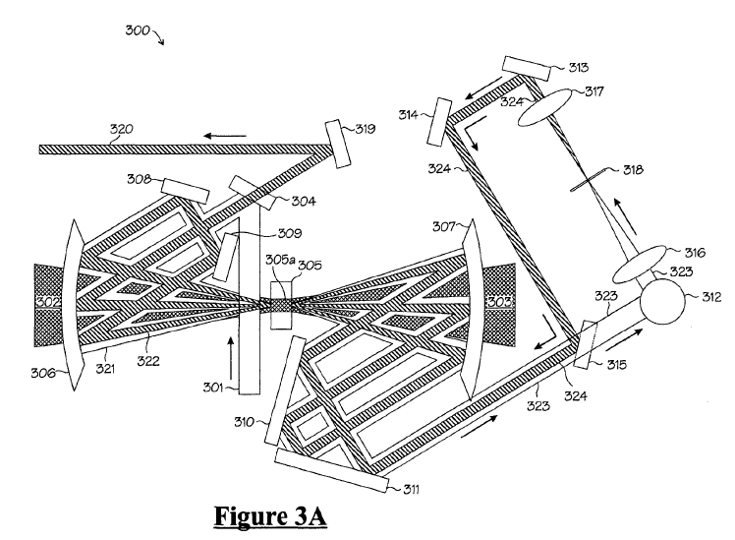
KLS Multi-Pass Amplifier

Slide 14
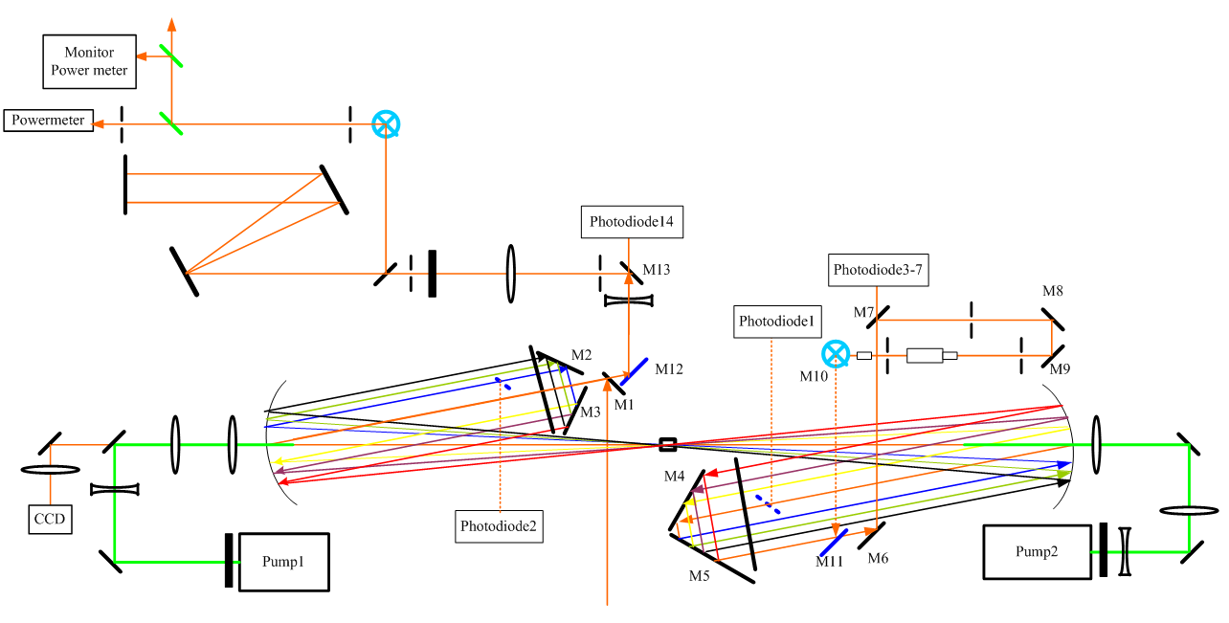
KLS Multi-Pass Amplifier

Slide 15
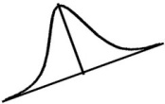
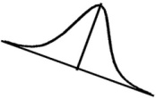
FROG: Beam Diagnostic
Infrared
Filter
BBO
M6
spectrometer
Translation
Stage
M3
M5
M2
M4
I₁(t)
I₂(t)
From Laser
M1
BS

Slide 16
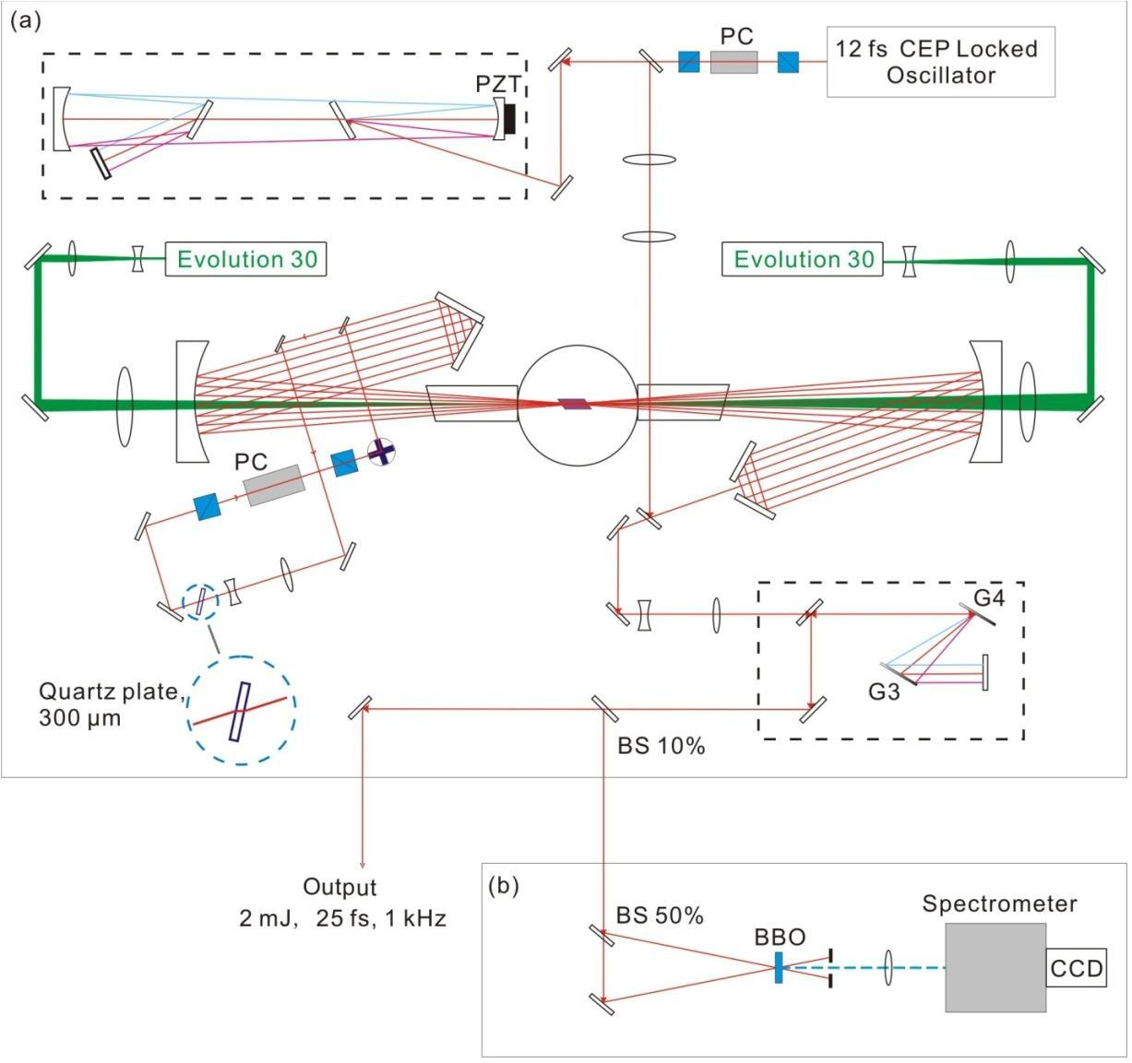
KLS system

Slide 17
KLS system timing
CEP Control
Menlo System
Delay Generator
SRS 645
Pump1
Pump2
PC1
PC2
2 kHz
PD1
80 MHz
Oscillator
PC1
PC2
PD2
PD3
PD4
Oscilloscope

Slide 18
KLS subsystems and devices
Oscillator: pump laser, crystal chiller, photo diode, Menlo timing controller
Amplifier: crystal chamber and vacuum pump, liquid nitrogen controller, Dewar, delay generator, pockels cells, pockels cell power supplies, pump lasers, pump laser power supplies, pump laser control computers, pump laser chillers, photo diodes, oscilloscope, power meter, power monitor, power locking PID (proportional–integral–derivative) controller, spectrometer, spectrometer computer
FROG: spectrometer, spectrometer computer, CCD camera, FROG computer
Other: power meters, mobile spectrometer, IR viewer, IR cards

Slide 19
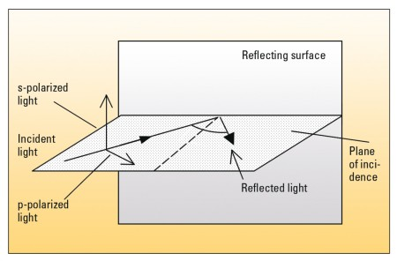
Optics
Coated Mirrors (metal or dielectric): reflectivity, phase, bandwidth, damage threshold
Beamsplitters: dielectric coating, reflectivity and transmission, phase, bandwidth, damage threshold
Lens and windows: coating, material, thickness
Wave plates: coating, material, thickness
Polarizer
Chirped mirror and compensation plates
Gratings and prisms
Nonlinear optical crystals

Slide 20
Safety
Wear your goggles
Know where the beam goes
Do not put your eyes at the beam height
Contact
Kun Zhao (Harry)
Baozhen Zhao
Al Rankin

Slide 21

Well, let’s see some real stuff now

Slide 22
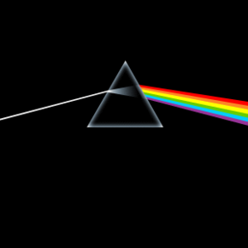
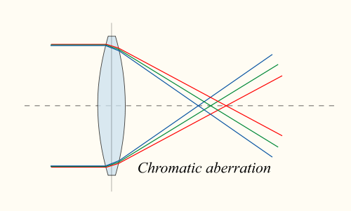
Spectrum, Dispersion, Chromatic Aberration

Slide 23
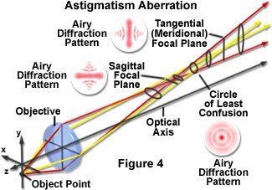
Chromatic and Astigmatism Aberrations
Of a Lens

Slide 24
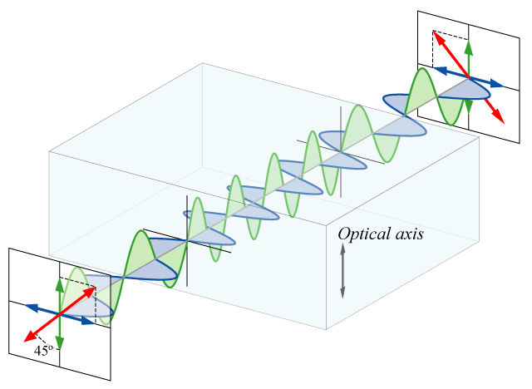
Birefringence and Wave Plate
Half-wave plate

Slide 25
Polarization, s or p

Slide 26
Energy, Power, Spectrum

Slide 29
Stretcher
CEP Lock
PC1
Seed
Femtolaser oscillator
Verdi-6
Evolution 30
Pump
Pump
Evolution 30
Amplifier
Compressor
PC2
Final Output

Slide 30
5µs
CE Control
Menlo System
Channel Timer
BNC 555B
A
B
C
D
Pump1380
Pump2302
PC11900
PC21940
System Timer
BNC 555A
f/16
2V
f/45
10ns
75 MHz, 1V
KLS Timing Jan 15, 2005
f/4
PD1
CE measure
Oscillator
PC1
PC2
Pulse Generator
Philips PM5712
PD2
PD3
PD4
1.5 V, jitter 1 ns
to Experiment
75M-1kHz
400 mV
1 kHz
150 mV
1 kHz, 1V
Oscilloscope
Tek TDS3054

Slide 31
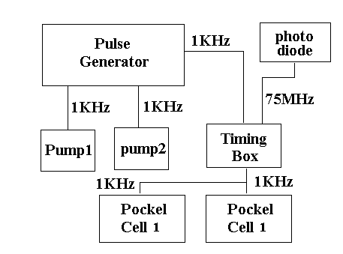

Slide 32
Laser Metrics 5046
Laser Metrics 5046
INPUT
7.5 kV
HV Adj
INPUT
7.5 kV
HV Adj
HV Bias
HV Bias
Q-SW CW
Q-SW CW
Trig Delay Width MON Outputs
Trig Delay Width MON Outputs
Pockels Cell 1
Long cable delay goes to control room
Pockels Cell 2
76 MHz kHz
Delay
DG535
DG535
Pump1: A: 510 ns; B: A + 5 μs
Pump2: C: 310 ns; D: C + 5 μs
Delay Unit: > 1 us
PC1: Delay 55 ns; Width 10 ns
PC2: Delay 45 ns; Width 10 ns
Photo Diode
OUT IN
0 AB CD
Master kHz signal is generated by DG535. PC1 is trigged by the kHz laser signal selected by the master signal and the signal from the photo diode. PC2 is trigged by the MON signal from PC1. Long cables are used for PC1 to compensate the trig delay of PC2
Pump1
Pump2

